Slide 1
A Literature Study about Named Entity Recognition on 2018 venue
Presenter: Longxu Dou
2019.3.25

Slide 2
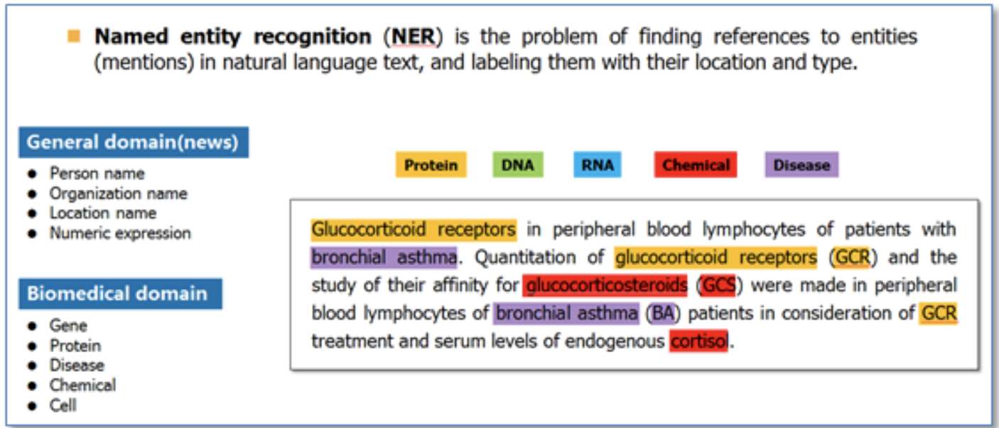
What is NER?
Notes:
命名实体识别（Named Entity Recognition，NER）就是从一段自然语言文本中找出相关实体，并标注出其位置以及类型，如下图。它是NLP领域中一些复杂任务（例如关系抽取，信息检索等）的基础。

Slide 3
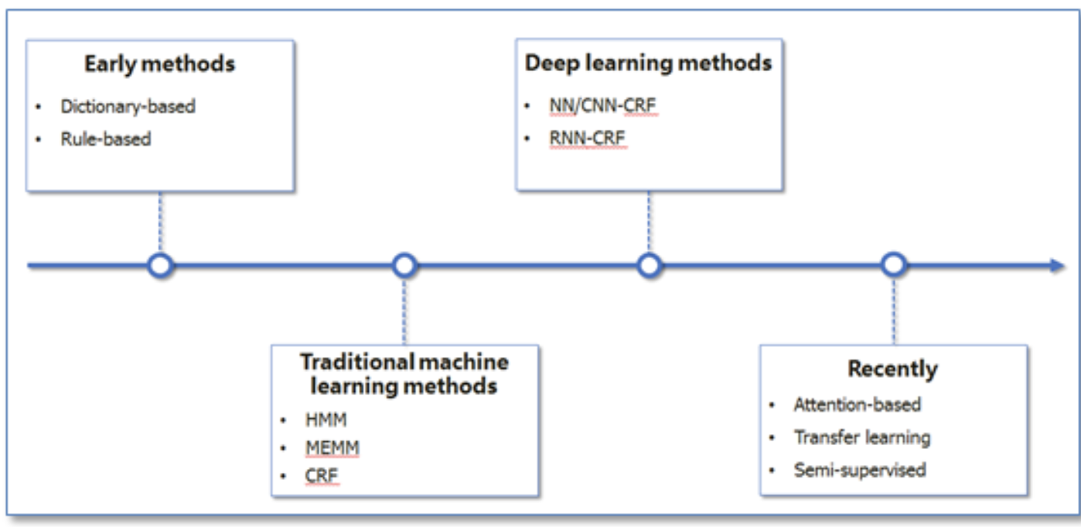
NER History
Notes:
NER一直是NLP领域中的研究热点，从早期基于词典和规则的方法，到传统机器学习的方法，到近年来基于深度学习的方法，NER研究进展的大概趋势大致如下图所示。

Slide 4
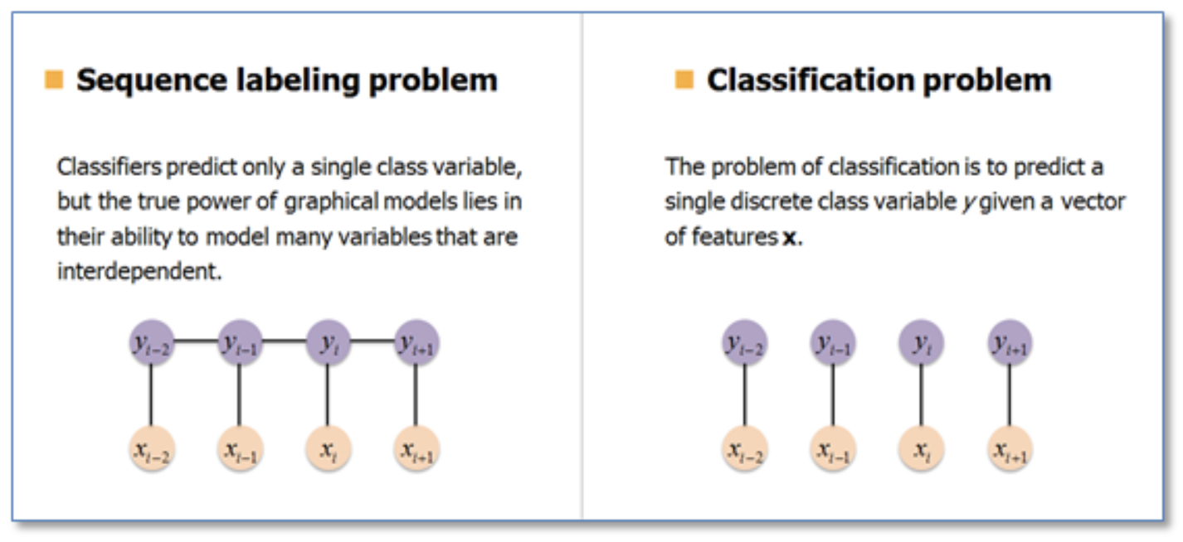
Problem Definition
Notes:
在基于机器学习的方法中，NER被当作是序列标注问题。与分类问题相比，序列标注问题中当前的预测标签不仅与当前的输入特征相关，还与之前的预测标签相关，即预测标签序列之间是有强相互依赖关系的。例如，使用BIO标签策略进行NER时，正确的标签序列中标签O后面是不会接标签I的。

Slide 5
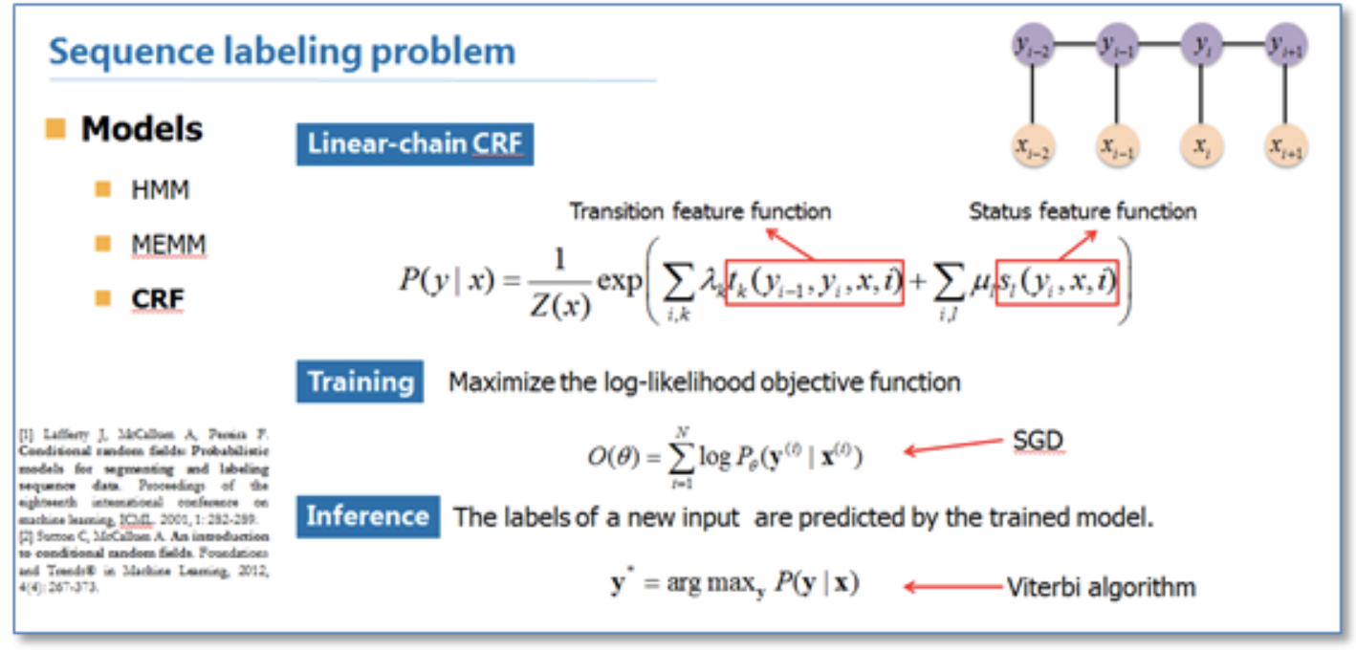
Sequence Labeling Problem

Slide 6
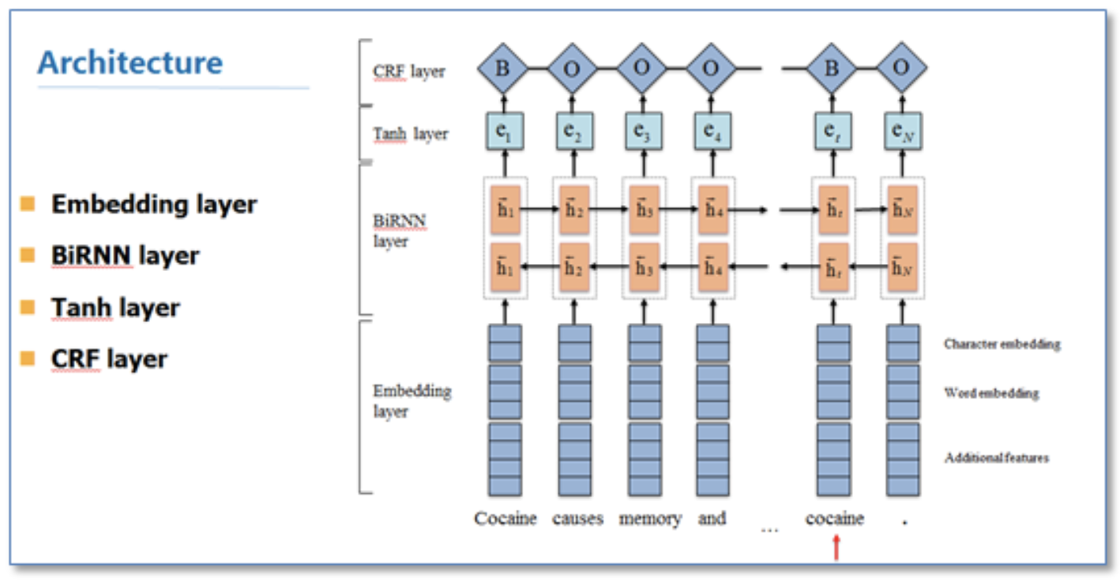
Neural Network CRF

Slide 7
Involved Paper
Neural Cross-Lingual Named Entity Recognition with Minimal Resources, NAACL2018
Learning Named Entity Tagger using Domain-Specific Dictionary,EMNLP2018
Deep Activate Learning for Named Entity Recognition, ICLR2018
Distantly Supervised NER with Partial Annotation Learning and Reinforcement Learning, COLING2018

Slide 8
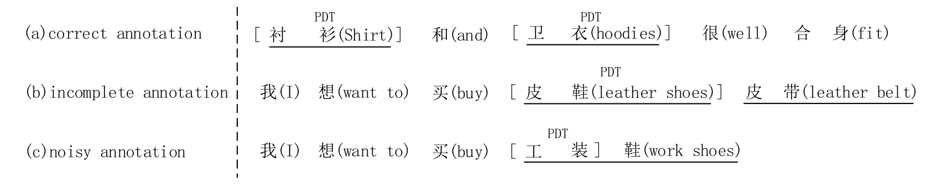
Distantly Supervised NER with Partial Annotation Learning and Reinforcement Learning

Slide 9
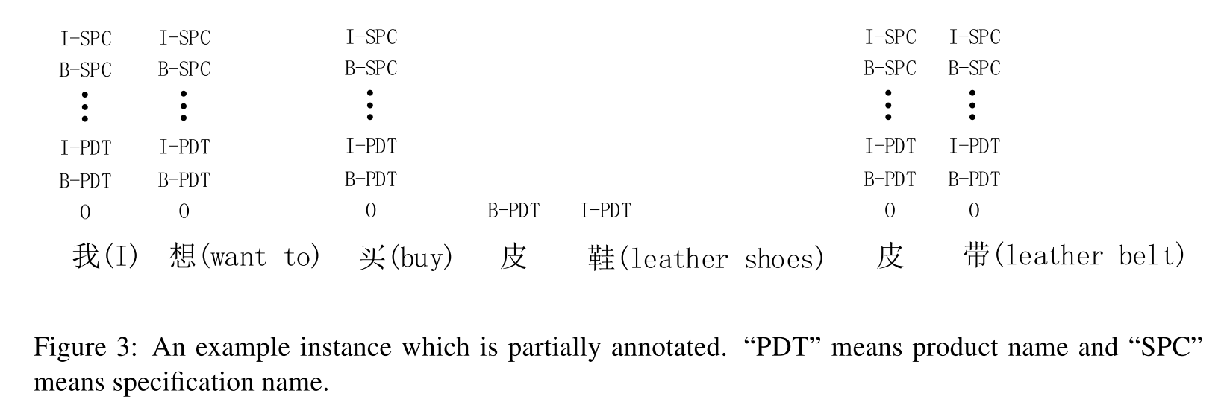
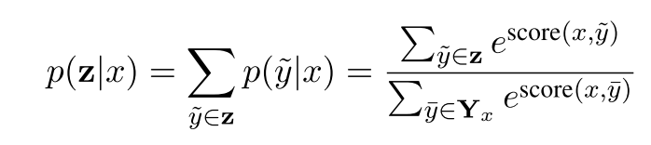
LSTM-CRF-PA for Incomplete Annotation
Notes:
﻿“PDT” means product name and “SPC” means specification name

Slide 10
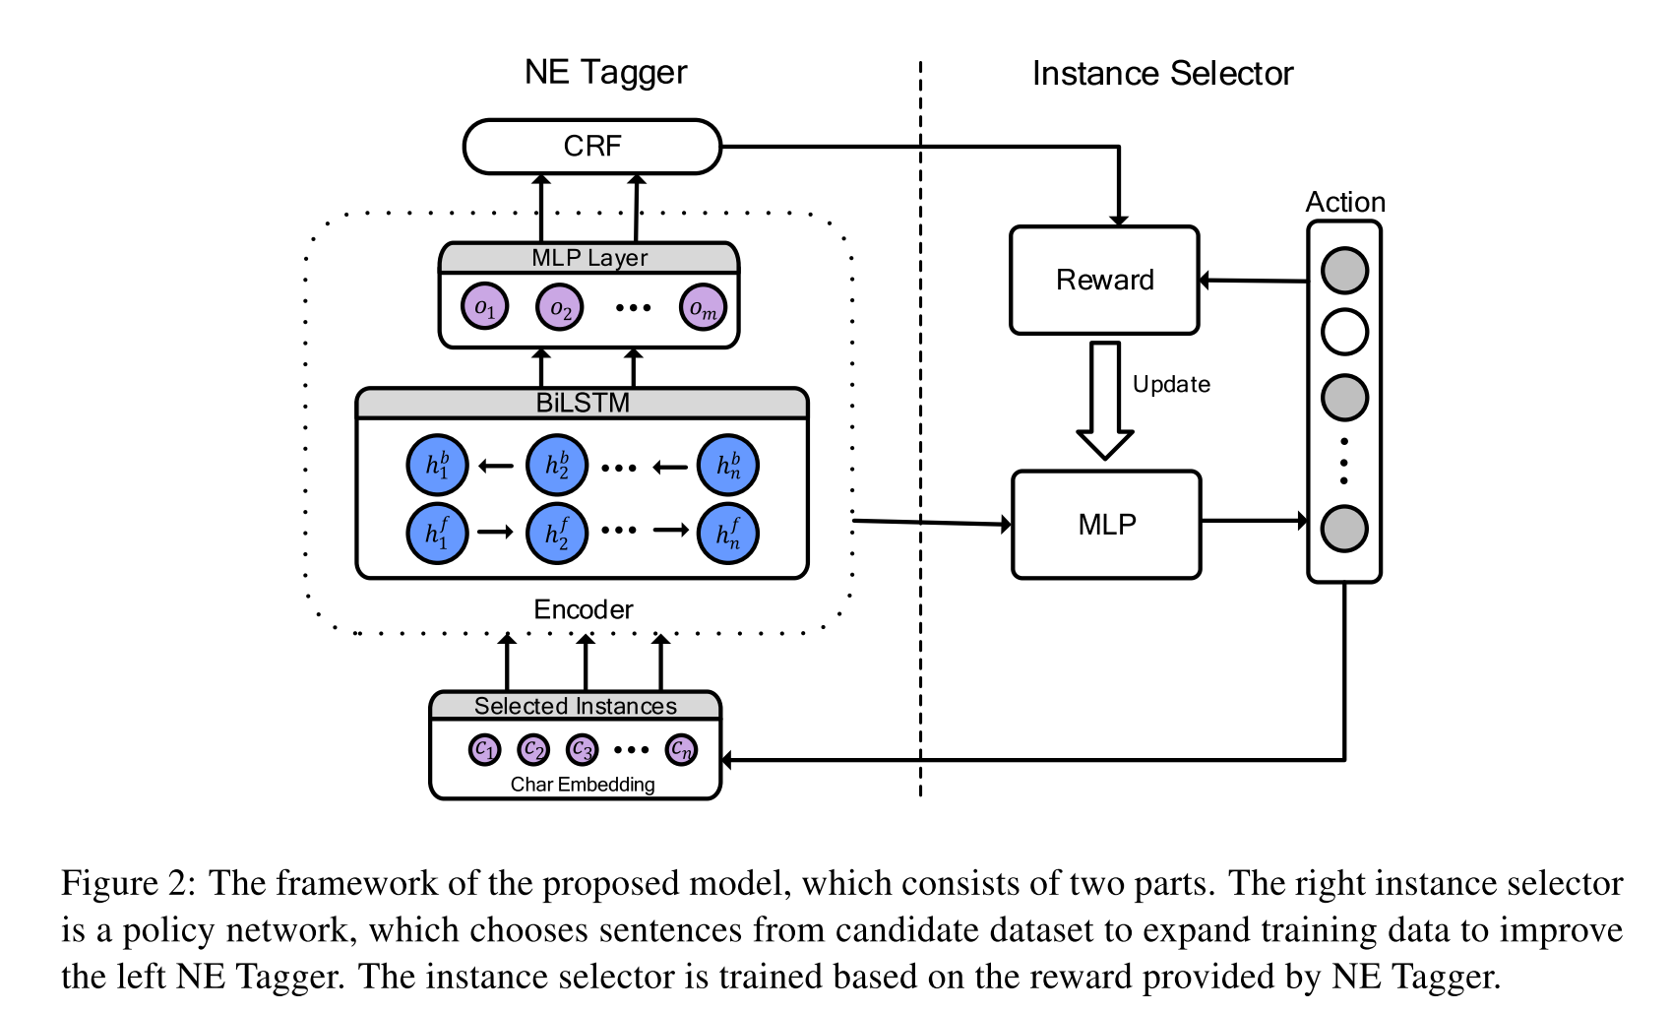
Framework

Slide 11
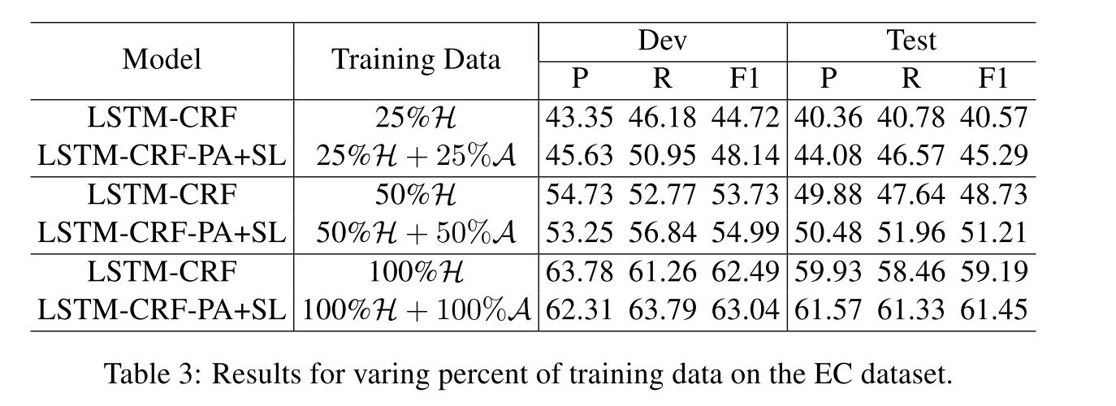
Results
Notes:
﻿We represent the state as a vector St, which consists of the following information: (1) The serialized vector representations of current instance, which are observed from the BiLSTM layer of baseline model. (2) The label scores calculated with output of the MLP layer from the shared encoder

Slide 12
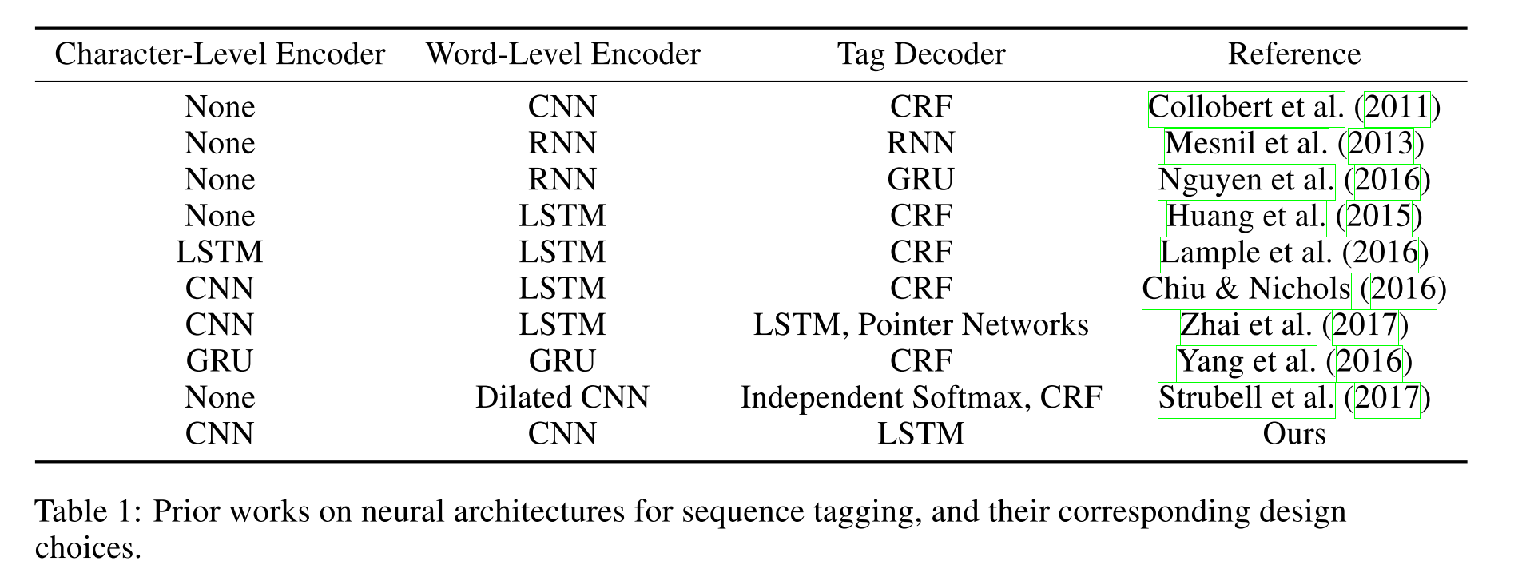
Deep Activate Learning for Named Entity Recognition

Slide 13
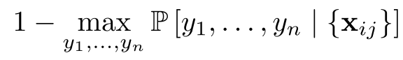
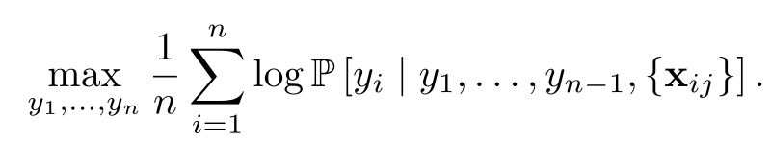
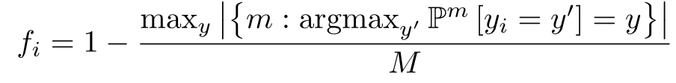
Uncertainty Sampling strategy
Least Confidence:
Maximum Normalized Log-Probability (MNLP):
Bayesian Active Learning by Disagreement (BALD):
Notes:
they propose that the variability of the predictions over successive forward passes due to dropout can be interpreted as a measure of the model’s uncertainty (Gal
﻿One measure of our uncertainty on the ith word is fi, the fraction of models which disagreed with the most popular choice:
maxy

Slide 14
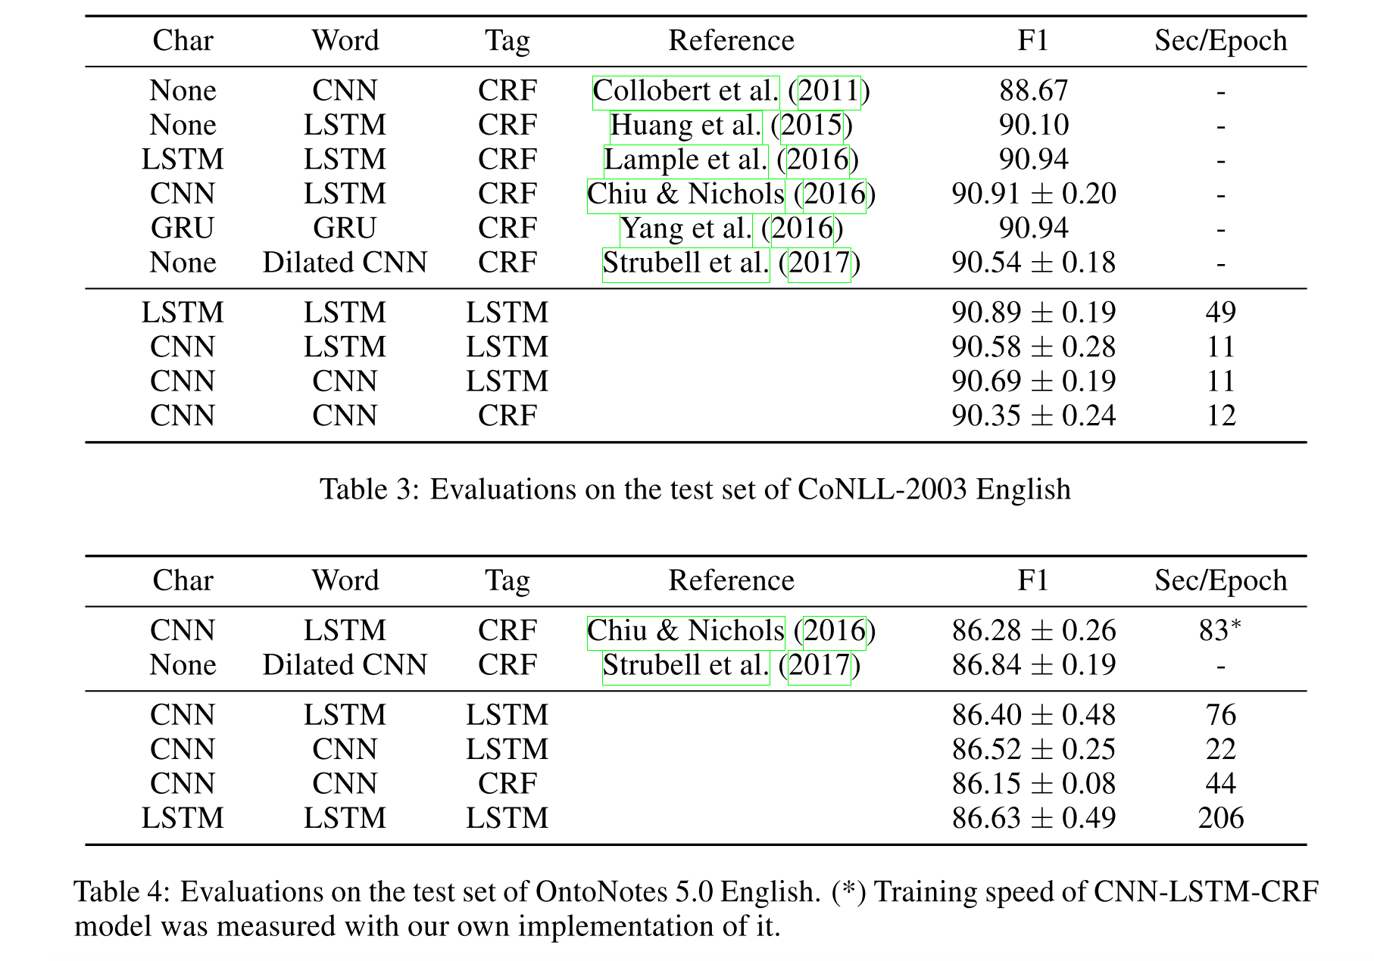
Result

Slide 15
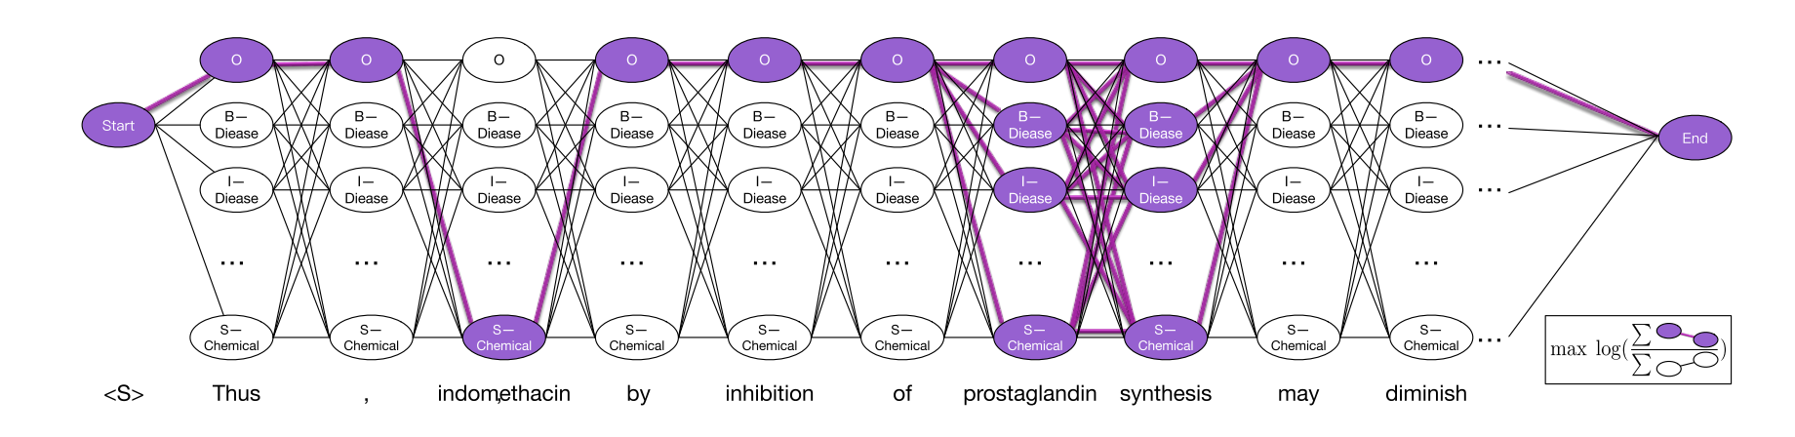
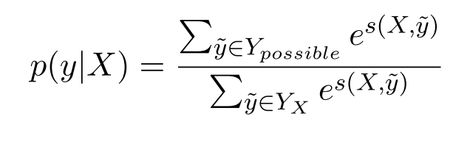
Learning Named Entity Tagger using Domain-Specific Dictionary
Fuzzy CRF

Slide 16
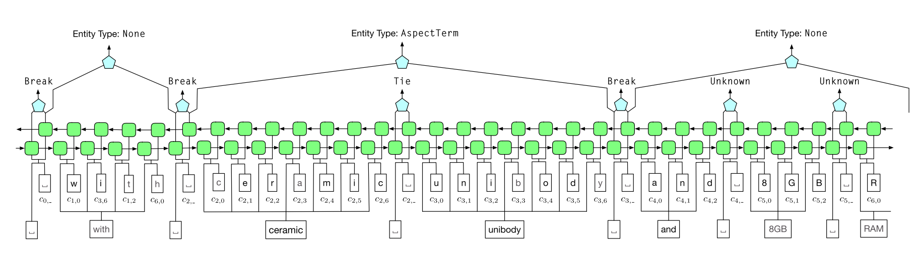
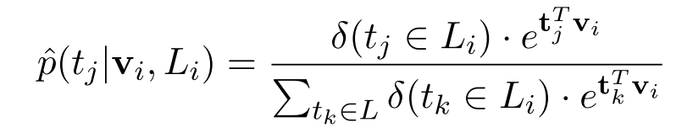
Tie or Break

Slide 17
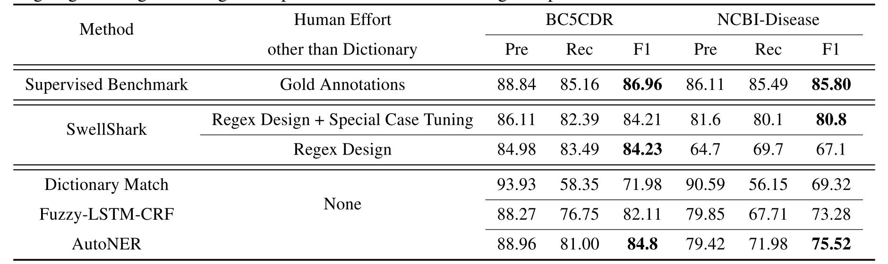
Performance

Slide 18
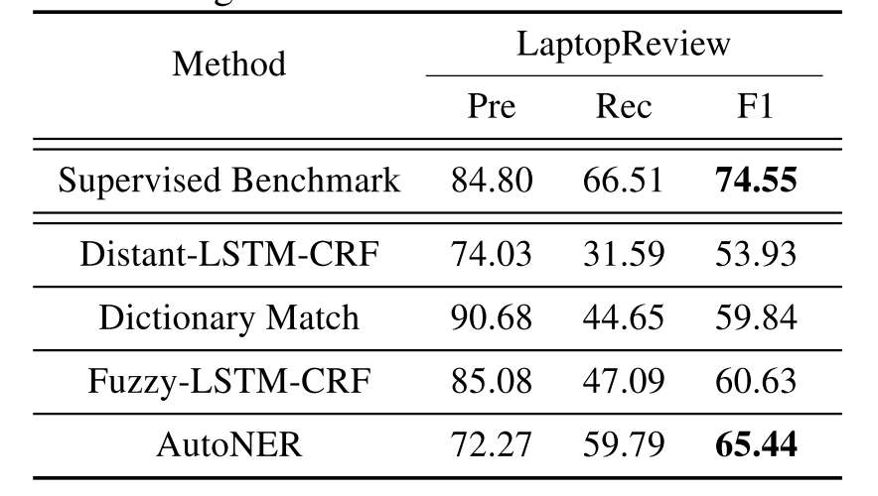
Performance

Slide 19
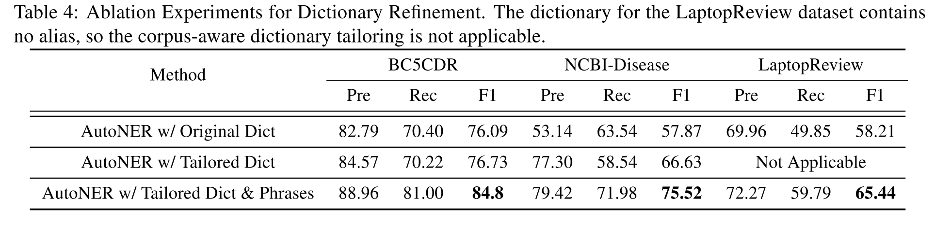
Dictionary Refinement

Slide 20
Neural Cross-Lingual Named Entity Recognition with Minimal Resources
Motivation:
It remains a challenge to apply NER models to languages with limited amounts of labeled data.
Problem:
how to effectively perform lexical mapping between the languages.
how to address word order differences.

Slide 21
Previous Methods
dictionary-based method
Use parallel corpora to project annotations between languages through word alignment.
However, these methods are largely predicated on the the availability of large-scale parallel resources.
Solution:
embedding-based method

Slide 22
Resource
Labeled training data in the source language.
Monolingual corpora in both source and target languages.
A dictionary, either a small pre-existing one, or one induced by unsupervised methods.

Slide 23
Pipeline
Train separate word embeddings using monolingual corpora
Project word embeddings in the two languages into a shared embedding space .
For each word in the source language training data, translate it by finding its nearest neighbor in the shared embedding space.
Train an NER model using the translated words along with the named entity tags from the English corpus

Slide 24
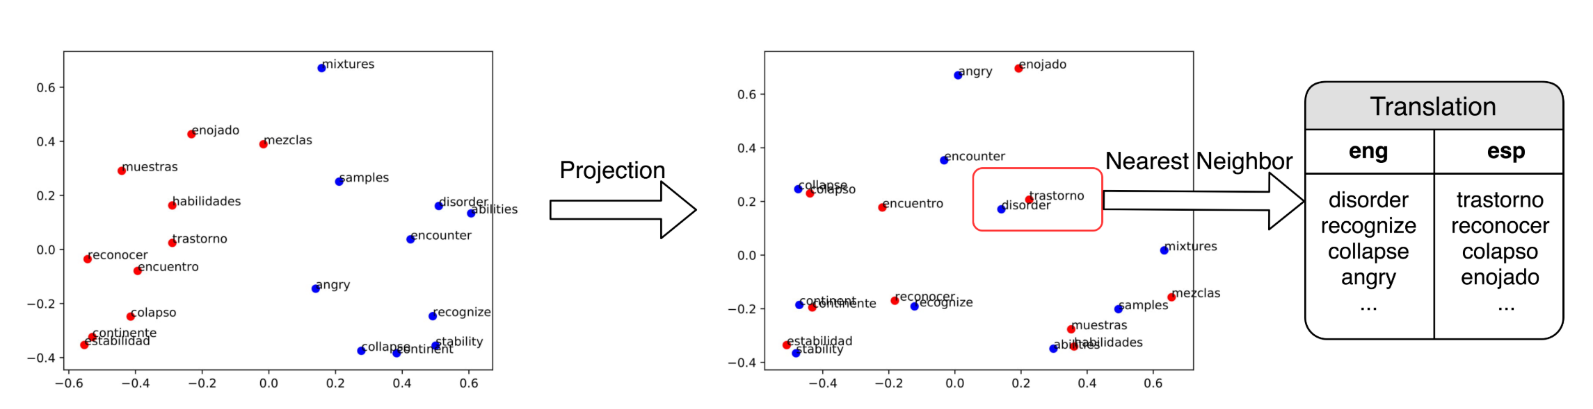
Learning Bilingual Embeddings

Slide 25
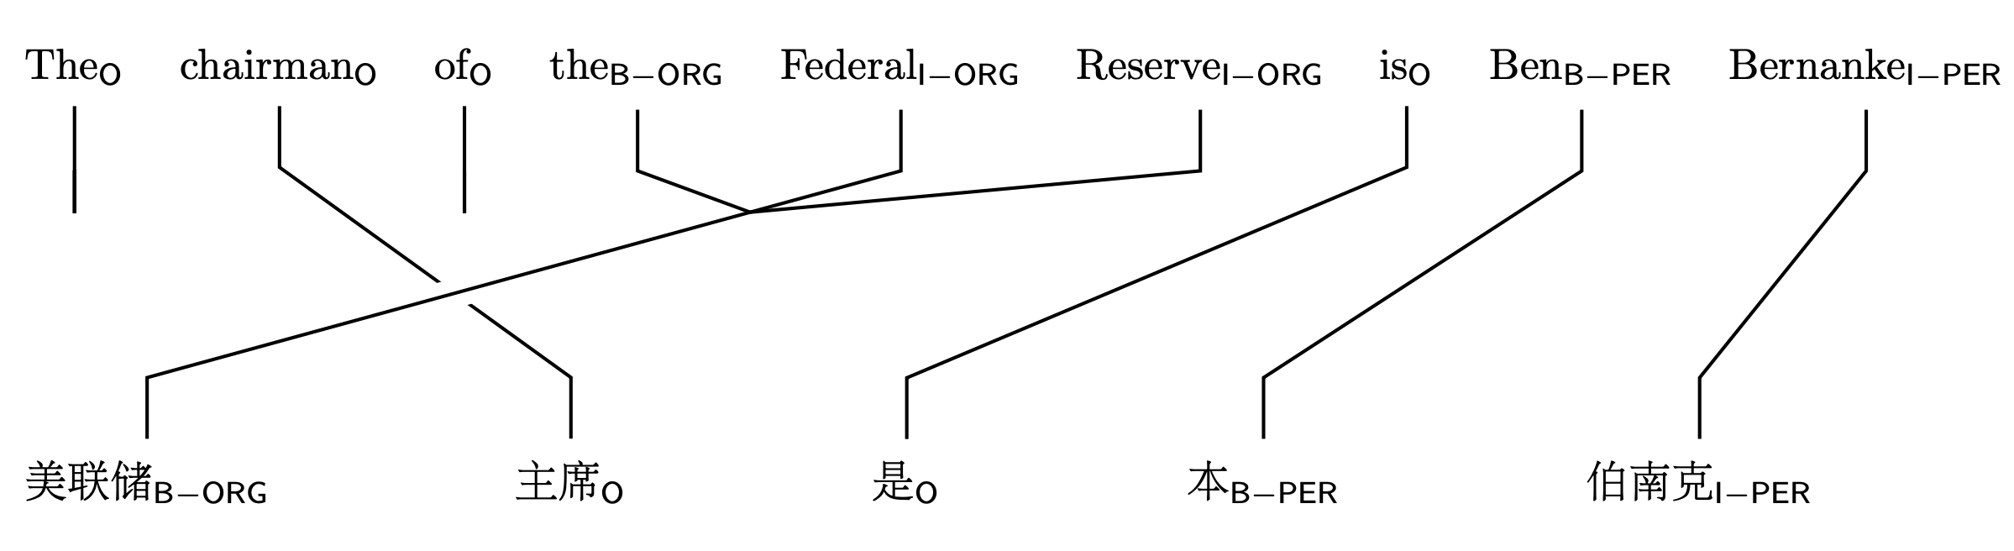
Word Order Differences
We propose to alleviate this problem by adding a self-attention layer on top of the word-level Bi-LSTM.

Slide 26
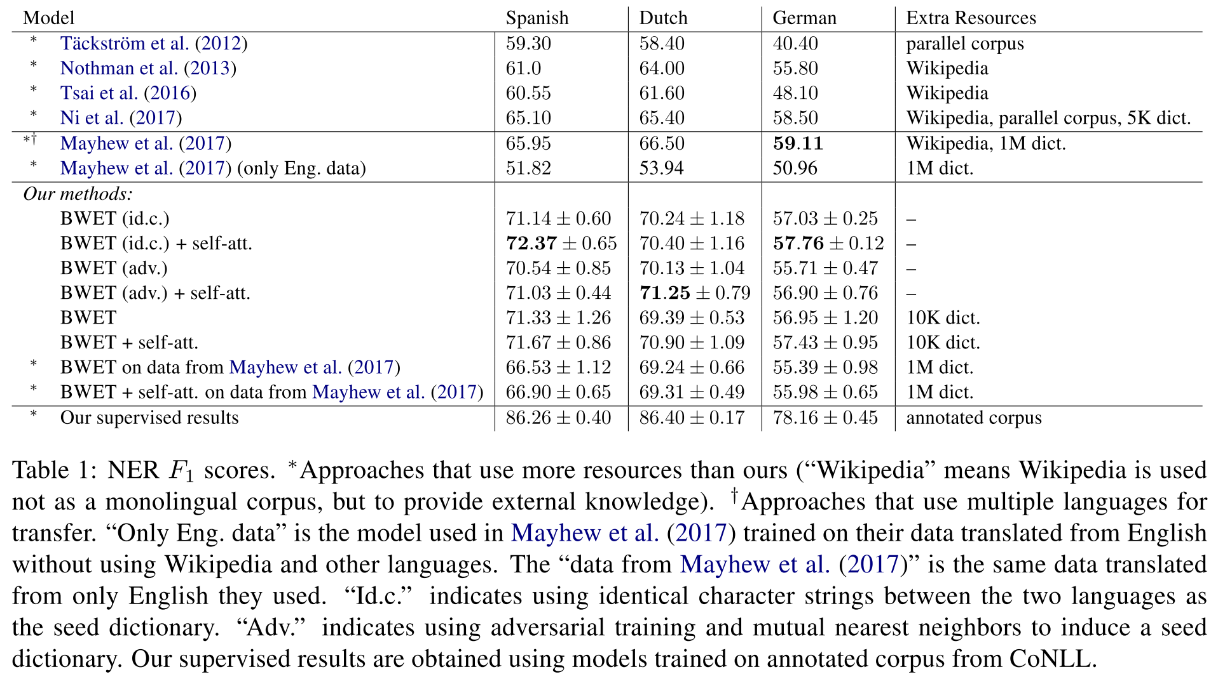
NER F1 scores
Notes:
﻿“Id.c.” indicates using identical character strings between the two languages as the seed dictionary
﻿“Adv.” indicates using adversarial training and mutual nearest neighbors to induce a seed dictionary.

Slide 27
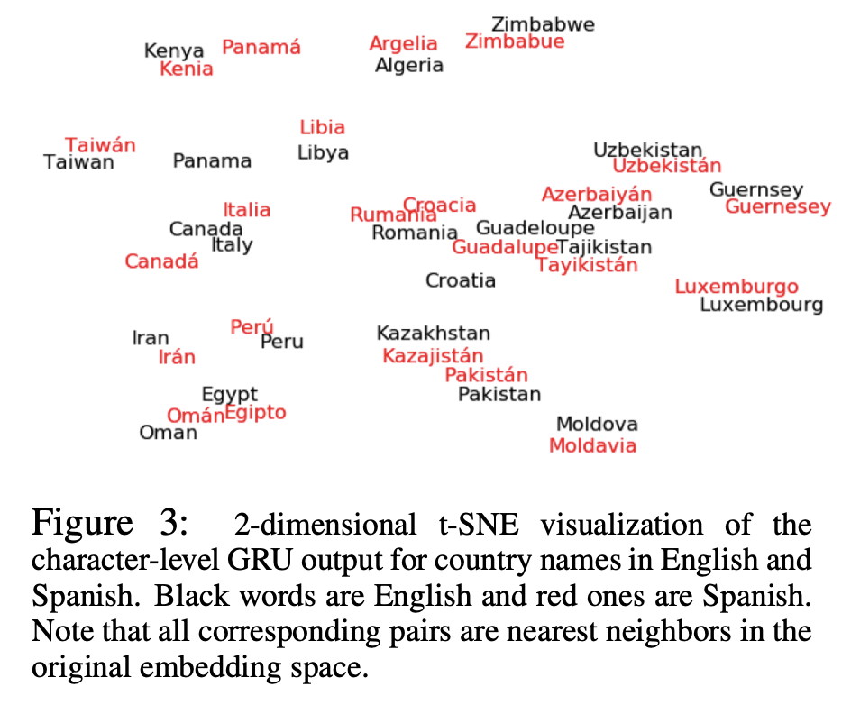
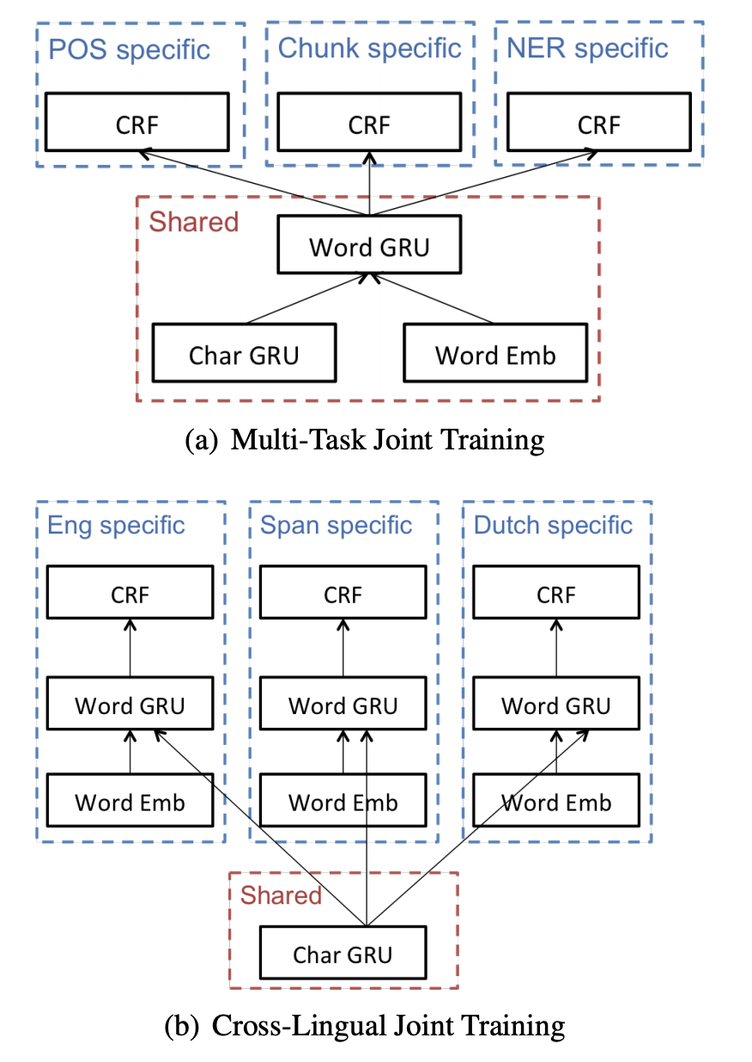
Multi-Task Cross-Lingual Sequence Tagging
Notes:
we mainly focus on leveraging morphological similarities for cross-lingual joint training

Slide 28
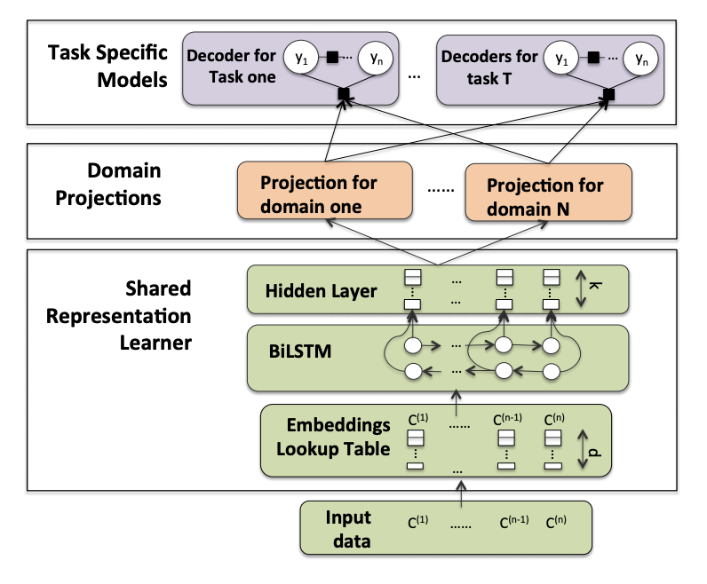
Multi-task Domain Adaptation for Sequence Tagging
Notes:
The bottom layer is shared by all tasks and domains. The domain projections contain one projection per domain and the task specific models (top layer) contain one model per task.
State-of-the-art results on Chinese word segmentation and named entity recognition in social media data.

